Slide 1
Annual Progress Conference
29-30 May 2012, Zagreb
TD-1002
COST Domain - Biomedicine and Molecular Biosciences (BMBS)

Slide 2
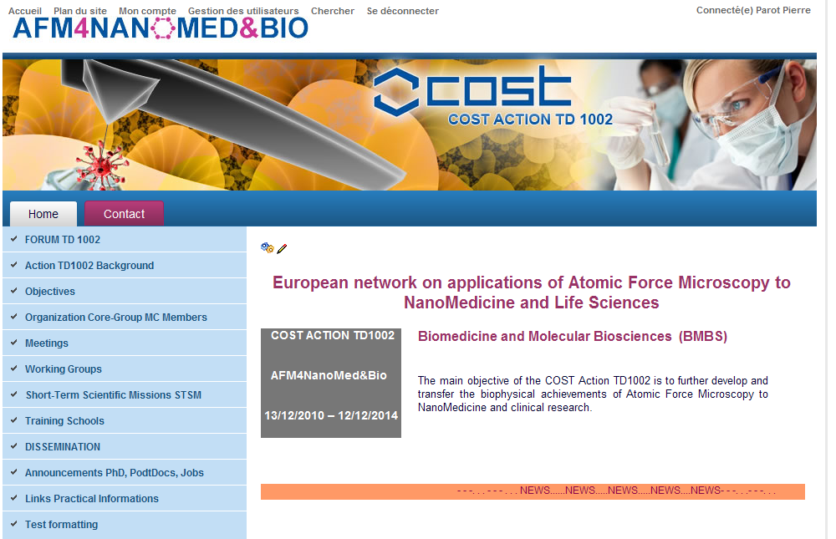
Notes:
COST Action TD 1002 website (including a FORUM) collect and give (at different filtered levels) all the info relative to the Action.

Slide 3
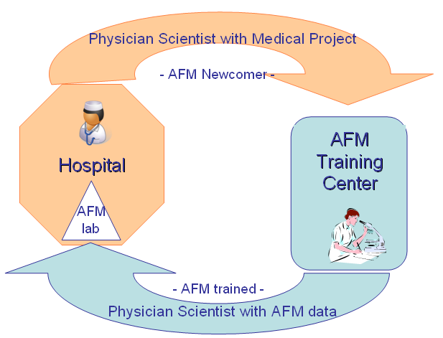
The main objective of the COST Action is to further develop and transfer the biophysical achievements of Atomic Force Microscopy to NanoMedicine and clinical research.
Is AFM useful in a clinical environment?
If yes, when, where, and how?

Slide 4
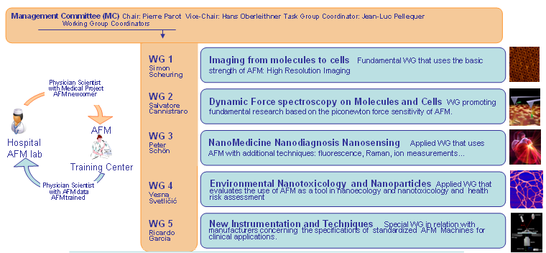

Slide 5
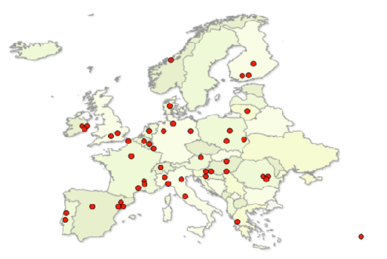
22 COST countries 2 pending
AT, BE, CH, DE, DK, EL, ES, FI, FR, HR, HU, IE, IL, IT, LT, LU, NL, NO, PL, PT, RO, SRB, TR, UK
Chair of the Action:
Prof. Pierre PAROT (FR)
Vice Chair of the Action:
Prof. Hans OBERLEITHNER (DE)
DC Rapporteurs:
Prof. Pavle ANDJUS (RS)
DC Rapporteurs:
Prof. Spiros H. ANASTASIADIS (EL)
Science officer of the Action:
Dr Magdalena RADWANSKA
Administrative officer of the Action:
Ms Gabriela CRISTEA

Slide 6
Meetings
2010 Kickoff Meeting Brussels, December 10 (LO: Magdalena Radwanska)
2011 WG Meeting Paris, May 10-13 (LO: Pierre Parot)
2011 MC Meeting August 23 // AFMBioMed Conference Paris 2011 (LO: Simon Scheuring)
2012 WG Meeting Linz February 3-4 // Linz Workshop 2012 (LO: Peter Hinterdorfer)
2012 MC Meeting Cracow September 14 (LO: Magorzata Lekka)
Schools
2011 Marcoule Summer School, August 30 – September 2; 26 trainees (LO: Jean-Luc Pellequer)
2012 Cracow Summer School, September 2012 (LO: Magorzata Lekka)

Slide 7
Outputs from the Networking
Need to define simple, robust and inexpensive instrument for cell diagnosis (which is the opposite to the current commercial AFM market)
Need to introduce Normalization and Standardization in AFM (includes data storage, image processing, and data processing in Dynamic Force Spectroscopy)
Need to establish stronger links with European AFM companies (which is not easy in a context of strong competition)
Notes:
Those are our new goals and targets. I would say: limited, precise and realistic objectives, raised by discussions and exchanges involving among the best AFM experts in Europe. You could even say that the scientific outcome of the first year was to realize that there is so much discrepancies in what each of us considered as well defined previously.

Slide 8
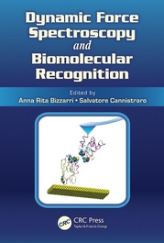
* Two-dimensional kinetiks of inter-connexin interactions from single-molecule force spectroscopy.
Rico F, Oshima A, Hinterdorfer P, Fujiyoshi Y, Scheuring S
J Mol Biol. 2011 Sep 9;412(1):72-9. Epub 2011 Jul 23.
* Nanomechanical characterization of stiffness of eye lens cells.
A. Hozic, F. Rico, A. Colom-Diego, N. Buzhynskyy, S. Scheuring
Investigative Ophthalmology & Visual Science, April 2012; 53 (4) 2151.
* Pilot in vivo toxicological investigation of boron nitride nanotubes.
Ciofani G, Danti S, Genchi GG, D’Alessandro D, Pellequer J-L, Odorico M, Mattoli V and Giorgi M
Int. J. Nanomed. (2012) 7: 19-24.
Books

Slide 9
* Atomic force microscopy characterization of silver nanoparticles interactions with marine diatom cells and extracellular polymeric substance.
G. Pletikapić, V. Žutić, I. Vinković Vrček, V. Svetličić, J. Mol. Recognit., (2012), DOI: 10.1002/jmr.2177.
* Polymer Networks Produced by Marine Diatoms in the Northern Adriatic Sea.
V. Svetličić, V. Žutić, T. Mišić Radić, G. Pletikapić, A. Hozić Zimmermann, and R. Urbani, Marine Drugs, 9 (2011) 666-679.
* Quantitative Nanomechanical Mapping of Marine Diatom in Seawater Using Peak Force Tapping AFM
G. Pletikapić, A. Berquand, T. Mišić Radić, and V. Svetličić, Journal of Phycology, 48 (2012) 174–185.
* Adhesive-free colloidal probes for nanoscale force measurements: Production and characterization.
Indrieri, M.; Podesta, A.; Bongiorno, G.; Marchesi, D.; Milani, P., Review of Scientific Instruments 2011, 82 (2), 023708-11.
* Fluorescence and atomic force microscopy imaging of wall teichoic acids in Lactobacillus plantarum.
Andre, Deghorain, va Swam, Kleerebezem, Hols and Dufrêne, ACS Chem. Biol., 6 (2011) 366-376.
* Effect of Antimicrobial Peptide-Amide: Indolicin on Biological Membranes.
Végh, Nagy, Balint, Kerényi, Rakhely, Varo and Szegletes, Journal of Biomedicine and Biotechnology, Vol 2011 (2011) ID 670589, 6 pages doi: 10.1155/2011/670589.
* Forces guiding assembly of light-harvesting complex 2 in native membranes.
Lu-Ning Liu, Katia Duquesne, Filipp Oesterhelt, James N. Sturgis, and Simon Scheuring , PNAS, June 7, 2011, 108 (23) 9455–9459.
* Two barriers for sodium in vascular endothelium?
Oberleithner, Annals of Medicine (2012), DOI: 10.3109/07853890.2011.653397, Mini Review
* Nanomechanics and Sodium Permeability of Endothelial Surface Layer Modulated by Hawthorn Extract WS 1442.
W. Peters, V. Drueppel, K. Kusche-Vihrog, C. Schubert, H. Oberleithner, PloS ONE, 2012, 7 (1) e29972.

Slide 10
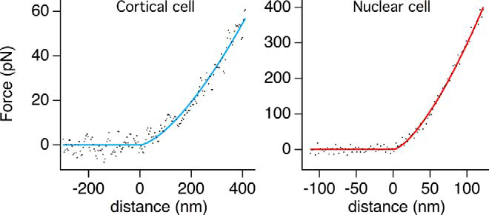
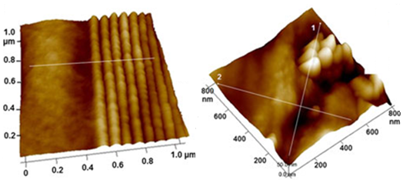
Nanomechanical characterization of eye lens cells and the effect of cytoskeletal drugs
WG1 and WG4
Nanoparticles and the environment Ag NPs and marine diatoms
WG4
Ag NP aggregtion in SW
Cytoskeletal drugs: no effect on cell elasticity
Ag NPs: diatom cell wall penetration

Slide 11
over 130 scientists participated (female 28% , Early Stage Researcher 35%)
Join WG meeting, Lamorlaye, France May 2011
Action MC / WG meeting coupled with AFMBioMed Paris 2011
Action WG meeting coupled with Linz Winter Workshop 2012
First Summer School: 26 trainees, 12 instructors
One bilateral agreement between two COST countries (FR and RO)
One pre-proposal entitled European Initiative, Cell nanomechanics as a diagnostic tool
One proposal for a European Grant on NanoToxicology
Current applications have been submitted to national funding agencies
FACTS
Only one STSM in 2011
STSM Purpose: Isolation of Fibroblast nuclei for Atomic force microscopy Applicant: Ms Ketaki Apte STSM Request TD1002-6720
Notes:
More than 130 scientists are now registered to TD-1002 website. Among them 26 trainees have attend Action First Summer School. Two Action meeting were coupled with international Conferences in the field of AFM for Life Sciences (AFMBioMed Paris 2011, Linz Winter Workshop 2012. One bilateral agreement between two COST countries (FR and RO) results directly from contacts established during a WG meeting.
People from WG3 have prepared and sent to EU a pre-proposal entitled European Initiative, Cell nanomechanics as a diagnostic tool. To our knowledge the idea was well received but was out of the scope of the call. This initiative will be continue because a wide consensus has been reached during the first join WG meeting.
People from WG4 have unsuccessfully applied for a European Grant about NanoToxicology.
Current applications have been submitted to national funding agencies. Results will be known in the summer 2012.

Slide 12
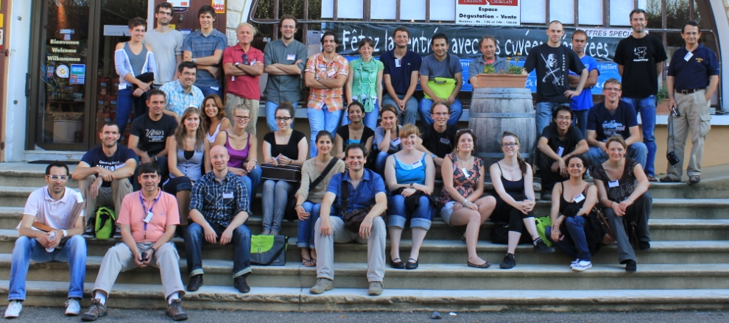
The Education Site, Leader: Alessandro Podesta, IT
COST Action TD 1002 Summer School 2011 Marcoule, France August 30 – September 2
26 trainees, 10 instructors
young (almost) and excellent gender balance!

Slide 13
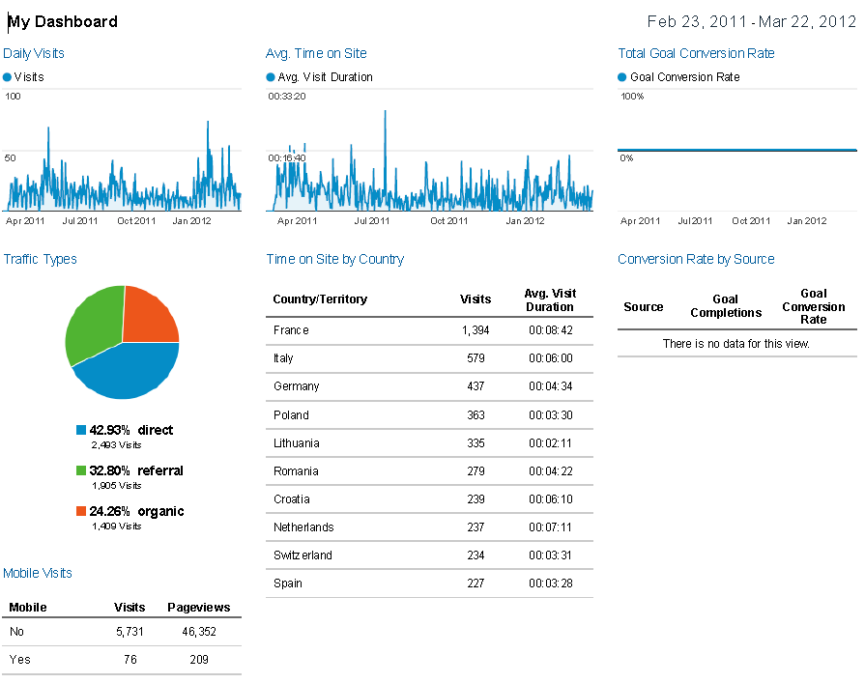
Annex

